Slide 1





Deep Learning-Based Intrusion Detection using CICIDS2017
Binary and multiclass intrusion detection system in cloud environments
Presented by:
Tamem Galeiw
Farah Mohamed
Jana Nawareg
Clara Wagdy

Slide 2
TABLE OF CONTENTS
01
Project overview
04
Binary Classification
02
Data Preprocessing
05
Multi-class Classification
Data Refinement Techniques
Conclusion
03
06

Slide 3

01
Project overview

Slide 4

Project overview
Goal: Detect cyber attacks in real-time network traffic.
Models: ANN, CNN, Random Forest, XGBoost.
Tasks:
Binary classification (Benign vs. Attack).
Multi-class classification (e.g., DDoS, Web Attack, Port Scan, etc.).
Techniques used:
Preprocessing: Cleaning, Scaling, Outlier Removal.
Handling imbalance: SMOTE.
Evaluation: Accuracy, F1-score, precision and recall

Slide 5
02
Data Preprocessing

Slide 6
DataSet overview
CICIDS2017 dataset (realistic network traffic)
Contains both benign and multiple attack types (DDos, PortScan, Web Attacks,..)
Stored in Parquet format (faster, cleaner than CSV)
Total rows: ~2.2M rows

Slide 7
Data Cleaning
Checked | Action taken
Missing values | None found
Infinite values and NaNs | None found
Duplicate rows | 82,000 rows removed (3.6%)
Columns with uniques value | 8 columns were removed Ex: Fwd Avg Bulk Rate
Standardizing column names | Whitespace trimmed special characters cleaned

Slide 8
Stratified Sampling
8.96%
Don’t have enough resources to process large data
Sampled 200,000 records using StratifiedShuffleSplit.
Maintained label proportions of benign vs. attack samples
Ensured rare attacks were represented fairly.
Ensures training models can generalize well on imbalanced real-world data.

Slide 9
Data Refinement Techniques
03

Slide 10
Refinement steps
Outlier Detection
Data Normalization
SMOTE for Class Imbalance

Slide 11
Outlier Detection
Network traffic may contain logging artifacts or burst anomalies that distort learning.
LOF detects points with lower local density than their neighbors.
Flagged and removed top 5% statistical outliers (contamination = 0.05).
Reduced noise, enhanced model stability, and preserved class distributions.
Excluded rare classes (Heartbleed, Infiltration) during LOF in multi-class to avoid false removal.
Reintegrated these classes after outlier removal.
Label | Before LOF | After LOF | % Reduction
Heartbleed | 1 | 0 | 100
Infiltration | 3 | 1 | 66.67
PortScan | 175 | 124 | 29.14
Bot | 129 | 114 | 11.63
DoS slowloris | 483 | 436 | 9.73
Benign | 169846 | 160985 | 5.22
DoS Slowhttptest | 469 | 451 | 3.84
DoS Hulk | 15489 | 14898 | 3.82
DDoS | 11472 | 11102 | 3.23
SSH-Patator | 288 | 279 | 3.12
DoS GoldenEye | 922 | 894 | 3.04
Web Attack – XSS | 58 | 57 | 1.72
FTP-Patator | 531 | 526 | 0.94
Web Attack – Brute Force | 132 | 131 | 0.76
Web Attack – Sql Injection | 2 | 2 | 0

Slide 12
Data Normalization
Min-Max Scaling applied to all numeric features
Transformed values to the range [0, 1]
Preserved original feature distribution
Prevented large-scale features from dominating training
Why Min-Max over other scalers?
Best suited for ANN and CNN
Retains feature shape and interpretability
More stable and faster convergence than StandardScaler or RobustScaler

Slide 13
Handling Class Imbalance (SMOTE)
Attack samples were underrepresented even after sampling.
Applied SMOTE (Synthetic Minority Oversampling Technique): - Interpolates new synthetic samples between real minority class instances. - Applied only to the training set (to avoid data leakage).
Chosen over random oversampling to avoid overfitting.
Result:
- Balanced training distribution.
- Enhanced model ability to detect attacks.
- Significantly improved recall and F1-score, especially for ANN.

Slide 14
Handling Class Imbalance (SMOTE)
 | Before SMOTE | After SMOTE
0 | 509 | 67296
1 | 52055 | 67296
2 | 3873 | 67296
3 | 67296 | 67296
4 | 2001 | 67296
5 | 2034 | 67296
6 | 2346 | 67296
7 | 5 | 67296
8 | 15 | 67296
9 | 740 | 67296
10 | 1277 | 67296
11 | 849 | 67296
Before SMOTE:
Some classes had as few as 2–20 samples.
After SMOTE:
All classes balanced at 67,296 samples each.
Training set expanded to 807,552 records.

Slide 15
Binary classification
04
Goal: Distinguish between benign and malicious network traffic

Slide 16
Confusion Matrix Outcomes and Evaluation Metrics
False Positives (FP) (Type I Error)
True Positives (TP)
Model successfully identified an actual attack or malicious activity as an attack.
Model incorrectly flagged normal, benign, or legitimate activity as an attack or malicious.
True Negatives (TN)
False Negatives (FN) (Type II Error)
Model correctly identified normal, benign, or legitimate activity as such.
Model failed to detect an actual attack or malicious activity, classifying it as normal or benign.

Slide 17
Confusion Matrix Outcomes and Evaluation Metrics
Recall
Measures how many real attacks the model correctly detected. High recall means few attacks were missed.
Recall = TP / (TP + FN)
F1 - Score
Balances precision and recall in one score. Useful when attack data is imbalanced.
F1 = 2 * (Precision * Recall) / (Precision + Recall)
Precision
Shows how many predicted attacks were actually attacks. High precision means fewer false alarms
Precision= TP / (TP + FP)
.

Slide 18
Random Forest
ANN
CNN
XGBoost

Slide 19
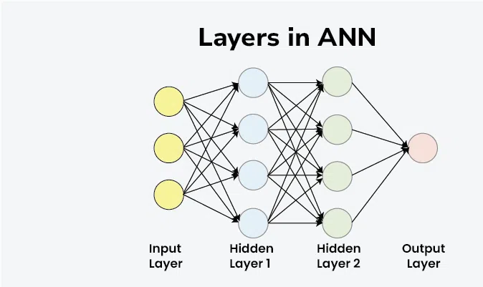
Overview of Artificial Neural Network (ANN)
Inspired by the human brain, ANN is composed of interconnected layers of nodes (neurons).
Consists of an input layer, one or more hidden layers, and an output layer.
Each connection has a weight that gets adjusted during training to minimize error.
Learns patterns and complex relationships from data using backpropagation and gradient descent.
Commonly used for classification, prediction, and pattern recognition tasks.

Slide 20
Binary classification: ANN
ANN Model Architecture:
Input Layer: Accepts features from the dataset
Hidden Layer 1: Dense (128) (Large enough to learn initial patterns) +ReLU + Dropout (0.3) to reduce overfitting
Hidden Layer 2: Dense(64) (learns more abstract combinations of features)+ReLU + Dropout(0.3)
Hidden Layer 3: Dense(32)(compressing learned info into smaller features), ReLU + Dropout(0.2)
Output Layer: Dense(1), Sigmoid activation.
Key Hyperparameters:
Optimizer: Adam
Efficient and adaptive learning rate.
Commonly used in deep learning models.
Loss Function: Binary Cross-entropy
Suitable for binary classification (Attack vs Benign).
Measures the error between predicted and actual values.

Slide 21
Binary classification: ANN
ANN Training :
Training settings
Epochs: 100
Batch Size: 128
EarlyStopping
Stops training if validation loss doesn’t improve for 10 epochs. (Stopped at 60)
Restored best weight at epoch 50

Slide 22
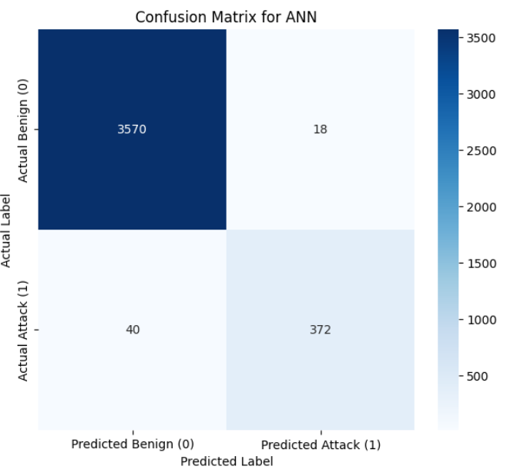
ANN confusion matrix
Metric | ANN
 | 0 | 1
Accuracy | 98.55% | 98.55%
Precision | 0.99 | 0.95
Recall | 0.99 | 0.90
F1-Score | 0.99 | 0.93

Slide 23
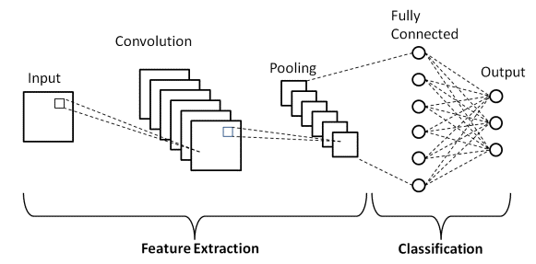
Overview of Convolutional Neural Network
(CNN)
CNNs are widely known for image recognition, but they also excel at analyzing sequential numerical data like network traffic.
CNNs automatically learn complex patterns and feature relationships, eliminating the need for manual feature extraction.
They are effective in detecting anomalies and suspicious behaviors across large volumes of traffic data.
Ideal for identifying network intrusions, even when the attack patterns previously unseen.

Slide 24
Binary classification: CNN
CNN Architecture :
→ Conv1D (64 filters, kernel size=3, activation=ReLU)
Learns local patterns in the sequence of features
→ MaxPooling1D (pool size=2)
Reduces dimensionality and focuses on dominant features.
→ Dropout (rate=0.3)
Randomly disables neurons to prevent overfitting during training
→ Conv1D (128 filters, kernel size=3, activation=ReLU)
Captures deeper and more abstract patterns from the data
→ Dropout (rate=0.5)
More aggressive regularization before dense layers.
→ Flatten Layer
Converts 2D feature maps into a 1D vector for fully connected layers.
→ Dense (128 units, activation=ReLU)
→ Output: Dense (1 unit, activation=Sigmoid)

Slide 25
Binary classification: CNN
Key Hyperparameters:
Optimizer: Adam
Efficient and adaptive optimizer that adjusts learning rate during training.
Well-suited for complex models and large datasets.
Loss Function: Binary Crossentropy
Measures the difference between predicted probabilities and actual labels (0 or 1).
Ideal for binary classification tasks like detecting attacks vs. benign traffic.
Epochs: 40
Number of full passes over the training data.
Early stopping is used to prevent overtraining if performance stops improving.

Slide 26
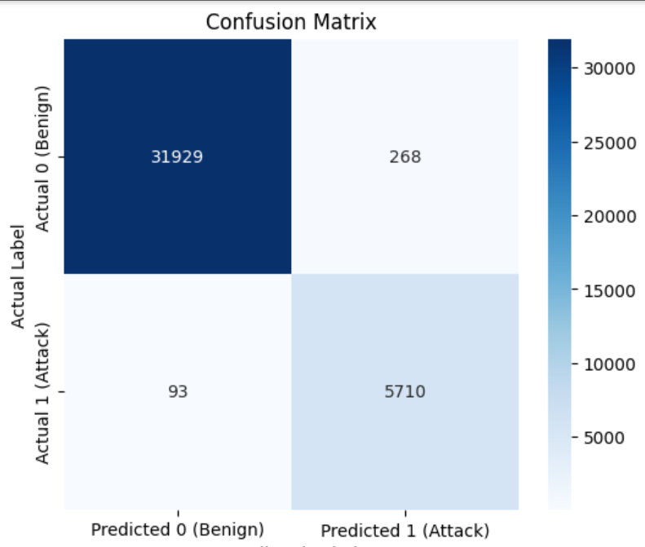
CNN confusion matrix
Metric | CNN
 | 0 | 1
Accuracy | 98.40% | 98.40%
Precision | 0.99 | 0.96
Recall | 0.99 | 0.98
F1-Score | 0.99 | 0.97

Slide 27
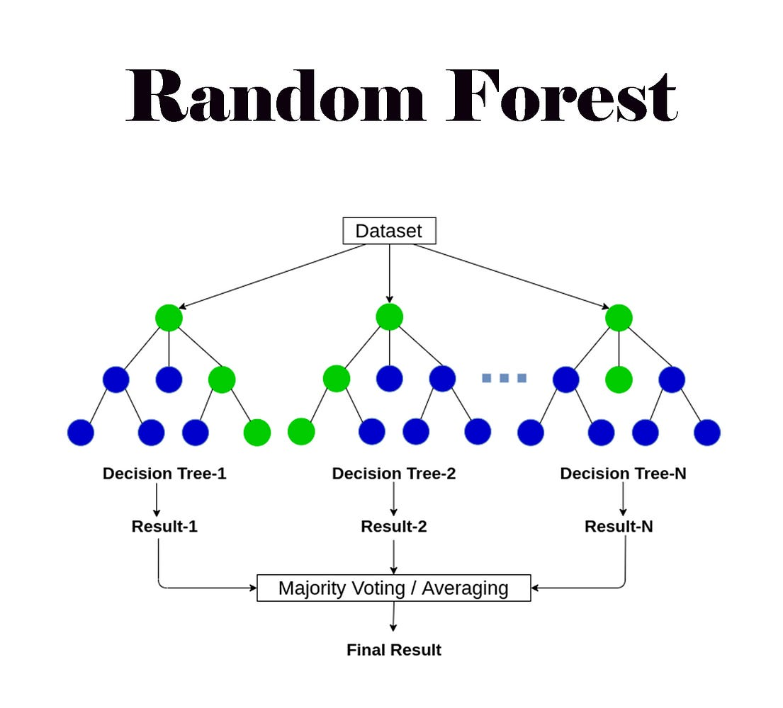
Overview of Random Forest
Overview:
Random Forest is an ensemble learning method based on decision trees.
It builds multiple trees and combines their results to improve accuracy and reduce overfitting.
Works for both classification and regression tasks.
How It Works:
Bagging: Random subsets of data are selected to train each tree.
Random Features: At each split, only a random set of features is considered.
Voting: For classification, each tree gives a prediction → the majority vote is taken.

Slide 28
Binary classification- Random Forest
Model Configuration
Number of Trees: 200 A large number of trees helps improve model stability and accuracy.
Class Weight: Balanced Automatically compensates for class imbalances in the dataset, ensuring better performance on minority classes.
Parallel Processing: Enabled The model uses all available CPU cores to speed up training.
Random State: Fixed Ensures consistent results across runs.

Slide 29
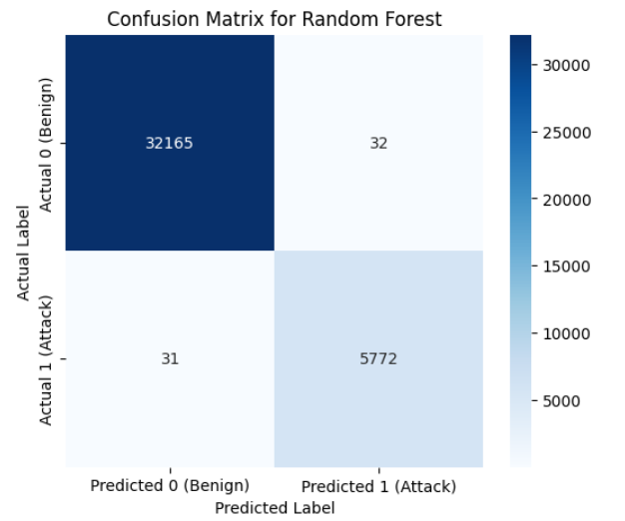
Random Forest confusion matrix
Metric | Random Forest
 | 0 | 1
Accuracy | 99.83% | 99.83%
Precision | 0.999 | 0.994
Recall | 0.999 | 0.99
F1-Score | 0.999 | 0.99

Slide 30
XGBoost Overview
Extreme Gradient Boosting: A powerful and scalable machine learning algorithm based on decision tree ensembles. It uses gradient boosting framework to improve performance through iterative learning.
Key concepts:
Boosting: Learns from previous mistakes to improve accuracy.
Regularization: L1 (feature selection) and L2 (prevents overfitting) for better generalization.
Gradient Descent: Minimizes loss at each step.
Cross-Validation: Built-in support to tune model and avoid overfitting.
Parallelization: Splits are built in parallel, making training fast.
Flexible: Works for classification and regression.
Model Advantages:
Can handle non-linear relationships.
More accurate than a single tree.
Resistant to overfitting through regularization and boosting.

Slide 31
Binary classification- XGBoost
Architecture :
Input Features → The numeric data (after encoding & scaling) is fed into the model.
Base Learners → XGBoost uses shallow decision trees (Keeps training fast+ prevents overfitting).
Boosting → Each new tree is trained to correct the errors made by the previous trees.
Function → binary:logistic, so the output is a probability score for binary classification.
Loss Function → log loss which gives a big penalty when the model is very confident but wrong.
Final Prediction → The outputs of all trees are combined (weighted sum), then passed through a sigmoid function to give a binary prediction (0 or 1).

Slide 32
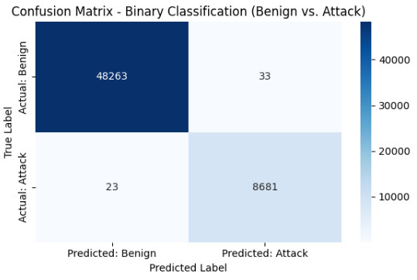
XGBoost confusion matrix
Metric | XGBOOST
 | 0 | 1
Accuracy | 99.9% | 99.9%
Precision | 0.999 | 0.996
Recall | 0.999 | 0.997
F1-Score | 0.999 | 0.996

Slide 33
Binary classification Comparison
Metric | ANN |  | CNN |  | Random Forest |  | XGboost
Accuracy | 98.55% |  | 98.40% |  | 99.83% |  | 99.92%
Precision | 0.97 |  | 0.98 |  | 0.99 |  | 0.997
Recall | 0.95 |  | 0.98 |  | 0.99 |  | 0.998
F1-Score | 0.96 |  | 0.98 |  | 0.99 |  | 0.997

Slide 34
Model Selection for Deployment
XGBoost: Best overall performance, ideal for real-time use
Ideal for Structured Data: XGBoost performs exceptionally well on tabular data, like the network flow features in this project.
Handles Imbalanced Data Well:
Built in support for weighted loss functions deals with data imbalance
Efficient and Scalable:
XGBoost trains fast and can handle large-scale cloud-based datasets.
Random Forest: Fast and reliable
- Not ideal for real time
-High memory usage
ANN: Strong choice within deep learning pipelines
CNN: Slightly lower recall; less suited for critical detection

Slide 35
05
Multi-class classification

Slide 36
The Experimental Journey: Refinements & Improvements

Slide 37
Stage | Change Implemented |  | Key Observation
Refinement 1 | Dropped Benign label |  | Data Loss: All samples of 'Heartbleed' & 'Infiltration' were deleted.
Improvement 1 | Intelligent LOF (Exempted rare classes) |  | Web Attack performance was poor. Brute Force: F-1 0.81 Sql Injection: F-1 0.00 XSS: F-1 0.07
Improvement 2 | Consolidated 'Web Attack' Class |  | The F1-score for the new 'Web Attack' class was now 0.95. Infiltration F-1 score is 0.5 because it had only 3 samples for the test
Improvement 3 | Increased Sample Size to 200,000 |  | Infiltration F-1 score went from 0.5 to 1.00

Slide 38
ANN
CNN
XGBoost

Slide 39
Multi-Class classification: ANN
ANN Model Architecture:
Input Layer: Accepts features from the dataset
Hidden Layer 1: Dense (128) with ReLU activation function + Dropout (0.3) to reduce overfitting
Hidden Layer 2: Dense(128), ReLU + Dropout(0.3)
Output Layer: Dense(12), SoftMax activation.
Key Hyperparameters:
Optimizer: Adam
Efficient and adaptive learning rate.
Commonly used in deep learning models.
Loss Function: sparse_categorical_crossentropy
Ideal for multi-class classification problems
Measures how different the model's predicted probability distribution is from the single correct class label.

Slide 40
Multi-class classification: ANN
ANN Training :
Training settings
Epochs: 50
Batch Size: 64
Validation Split: 20% of the training data used for validation
EarlyStopping
Stops training if validation loss doesn’t improve for 10 epochs. (Stopped at 28)
Restored best weight at epoch 18
ANN model training complete in 16 minutes.

Slide 41
Multi-class ANN classification
Attacks | Bot | DDoS | DoS GoldenEye | DoS Hulk | DoS Slowhttptest | DoS slowloris | FTP-Patator | Heartbleed | Infiltration | PortScan | SSH-Patator | Web Attack
Accuracy | 99.89%
Precision | 1.00 | 1.00 | 0.98 | 0.999 | 0.997 | 0.99 | 1.00 | 1.00 | 1.00 | 1.00 | 0.97 | 0.99
Recall | 1.00 | 0.999 | 1.00 | 0.999 | 0.99 | 0.997 | 0.999 | 1.00 | 1.00 | 0.97 | 0.996 | 0.96
F1-score | 1.00 | 0.999 | 0.99 | 0.999 | 0.995 | 0.99 | 0.999 | 1.00 | 1.00 | 0.98 | 0.98 | 0.97

Slide 42
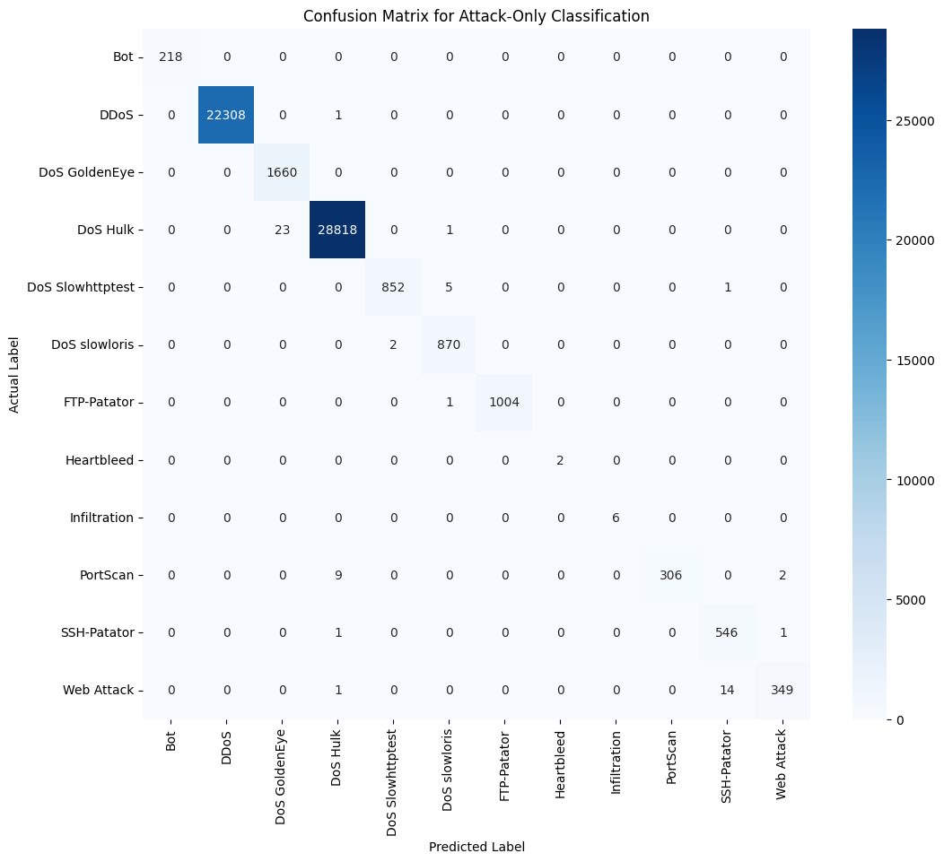

Slide 43
Multi-Class classification: CNN
Architecture Diagram:
→ Conv1D(64 filters, kernel size=3, ReLU)
→ MaxPooling1D(pool size=2)
→ Dropout(0.3)
→ Conv1D(128 filters, kernel size=3, ReLU)
→ MaxPooling1D(pool size=2)
→ Dropout(0.5)
→ Flatten
→ Dense(128, ReLU)
→ Output: Dense(12, SoftMax)
Key Hyperparameters:
Optimizer: Adam
Loss: sparse_categorical_crossentropy
Dropout: 0.3 / 0.5

Slide 44
Multi-class classification: CNN
CNN Training:
Training settings
Epochs: 50
Batch Size: 64
Validation Split: 20% of the training data used for validation
EarlyStopping
Stops training if validation loss doesn’t improve for 10 epochs. (Stopped at 19)
Restored best weight at epoch 9
CNN model training complete in 1 hour and 19 mins.

Slide 45
Multi-class CNN classification
Attacks | Bot | DDoS | DoS GoldenEye | DoS Hulk | DoS Slowhttptest | DoS slowloris | FTP-Patator | Heartbleed | Infiltration | PortScan | SSH-Patator | Web Attack
Accuracy | 99.85%
Precision | 0.97 | 1.00 | 0.98 | 0.999 | 0.997 | 0.99 | 1.00 | 1.00 | 1.00 | 1.00 | 1.00 | 0.91
Recall | 1.00 | 0.999 | 1.00 | 0.999 | 0.99 | 0.997 | 0.999 | 1.00 | 1.00 | 0.96 | 0.94 | 0.997
F1-score | 0.98 | 0.999 | 0.99 | 0.999 | 0.995 | 0.995 | 0.995 | 1.00 | 1.00 | 0.98 | 0.97 | 0.95

Slide 46


Slide 47
Multi-class classification-XGBoost
Architecture:
Input Features → The numeric data (after encoding & scaling) is fed into the model.
Base Learners → XGBoost uses an ensemble of shallow decision trees (also called weak learners).
Boosting → Each new tree is trained to correct the errors made by the previous trees.
Function → multi:softmax, This function's goal is to assign each input to one, and only one, of the 12 specific attack classes.
Loss Function → mlogloss (for Multi-Class Model), It measures how far away the model's predicted probability is from the actual label
Final Prediction → The outputs of all trees are combined (weighted sum) and the model directly outputs the single class label (e.g., 0 for 'Bot', 3 for 'DoS Hulk', etc.) that it predicts as the most likely answer.
Training time: 4 minutes

Slide 48
Multi-class XGboost classification
Attacks | Bot | DDoS | DoS GoldenEye | DoS Hulk | DoS Slowhttptest | DoS slowloris | FTP-Patator | Heartbleed | Infiltration | PortScan | SSH-Patator | Web Attack
Accuracy | 99.92%
Precision | 1.00 | 1.00 | 0.99 | 0.999 | 0.995 | 0.99 | 1.00 | 1.00 | 1.00 | 0.94 | 0.998 | 0.99
Recall | 1.00 | 1.00 | 0.999 | 0.998 | 0.995 | 0.995 | 1.00 | 1.00 | 1.00 | 0.99 | 0.998 | 0.99
F1-score | 1.00 | 1.00 | 0.996 | 0.999 | 0.995 | 0.99 | 1.00 | 1.00 | 1.00 | 0.96 | 0.998 | 0.99

Slide 49


Slide 50
Multi-class classification Comparison
Metric | ANN |  | CNN |  | XGboost
Accuracy | 99.89% |  | 99.85% |  | 99.92%
Precision | 0.995 |  | 0.988 |  | 0.992
Recall | 0.992 |  | 0.991 |  | 0.997
F1-Score | 0.993 |  | 0.989 |  | 0.995

Slide 51
Model Selection for Deployment
XGBoost: Achieved the highest scores across all key metrics and was by far the fastest to train (4 minutes), making it the most reliable and efficient choice for deployment.
ANN: Delivered excellent and highly comparable results with a much faster training time (16 minutes) than the CNN, proving it is a very strong and effective deep learning choice.
CNN: Also performed exceptionally well but had the longest training time (1 hr 19 mins) and a slightly lower recall, making it a viable alternative, though the ANN and XGBoost are more practical.

Slide 52
Conclusion
06

Slide 53
Successfully developed and evaluated multiple high-performance models for intrusion detection, leveraging both deep learning and ensemble techniques.
Preprocessing steps (cleaning, scaling, startified sampling, SMOTE, LOF) greatly improved data quality and model performance.
Binary and multi-class classification models were evaluated.
XGBoost achieved high accuracy and strong recall, especially after SMOTE and LOF in both binary and multi-class classification.

Slide 54
Future work
07

Slide 55
While our final model is highly effective, the research identified clear avenues for future enhancement:
Addressing Ultra-Rare Classes:
The primary remaining challenge is the detection of classes with extremely low support, like 'Infiltration'.
Future work should focus on Targeted Data Collection, employing tools like honeypots to capture more real-world examples of these specific attacks.

Slide 56
Thank you
Any questions?

